Slide 1

Data Science around the world
satRday Kampala
@theStephLocke #satRdayKampala @satRdays_org

Slide 2
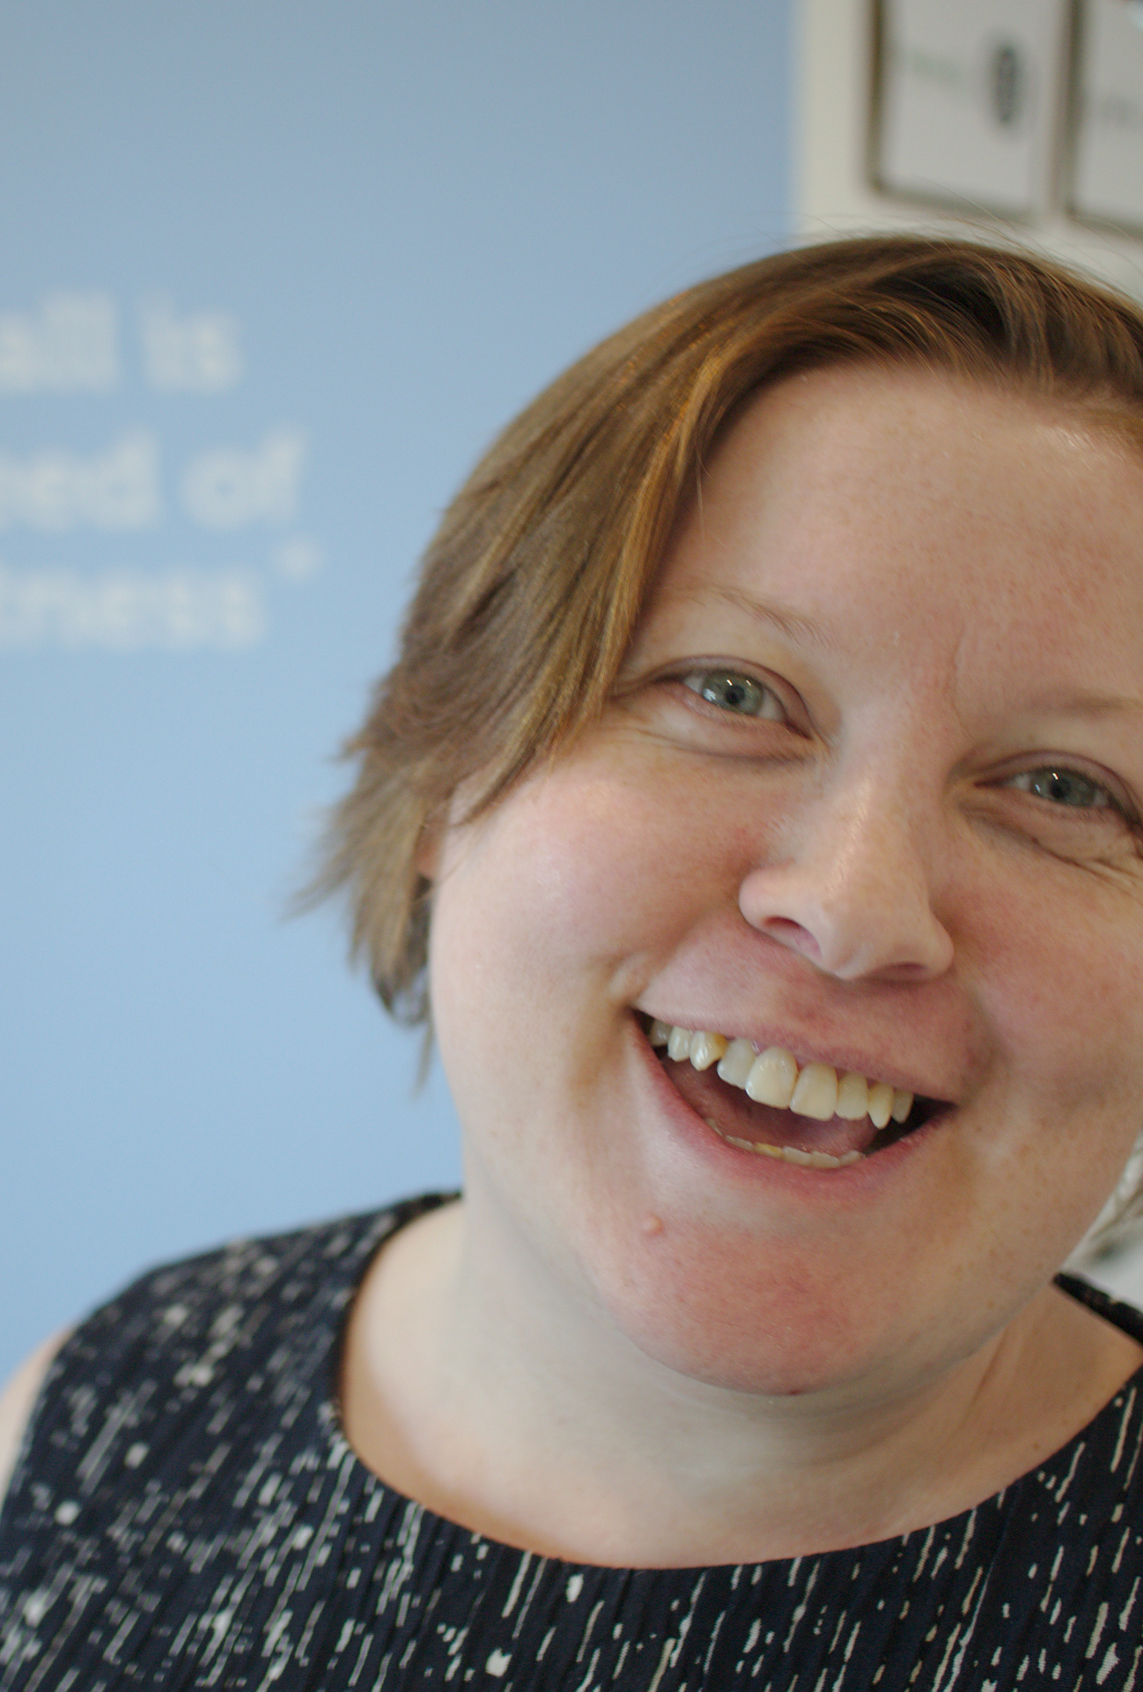
Steph Locke
satRdays global founder
Data Scientist
CEO Consultant @ Locke Data
CEO @ Nightingale HQ
Author
@theStephLocke
steph@itsalocke.com
@theStephLocke #satRdayKampala @satRdays_org

Slide 3
satRdays
Open
Cheap
R
Global
Local
Not for profit
@theStephLocke #satRdayKampala @satRdays_org

Slide 4
satRdays Over time
2016 1
2017 1
2018 5
2019 (T) 7
2019 >11
@theStephLocke #satRdayKampala @satRdays_org

Slide 5
satRdays By Continent
Africa 4
Europe 6
North America 3
Oceania 0
South America 1
Asia 0
@theStephLocke #satRdayKampala @satRdays_org

Slide 6
Data Science R community
Groups
R UGs
R Ladies
Conferences
UseR!
Various
Online
R4DS
#rstats
@theStephLocke #satRdayKampala @satRdays_org

Slide 7
Data Science Python community
Groups
PyData
PyLadies
Conferences
PyCon
PyData
Online
KaggleNoobs
#python
@theStephLocke #satRdayKampala @satRdays_org

Slide 8
Get involved
Volunteer
Organise
Present
Blog
Host
Code
@theStephLocke #satRdayKampala @satRdays_org

Slide 9
Data Science
Data science is a multi-disciplinary field that uses scientific methods, processes, algorithms and systems to extract knowledge and insights from structured and unstructured data. Wikipedia
@theStephLocke #satRdayKampala @satRdays_org

Slide 10
Data Science Roles
(BI) Analyst
ML Engineer
Data Engineer
Data Scientist
Statistician
@theStephLocke #satRdayKampala @satRdays_org

Slide 11
Advice
Education
Portfolio
Business
@theStephLocke #satRdayKampala @satRdays_org

Slide 12
Next steps
Today
Network
Learn
Tomorrow
Email steph@itsalocke.com for PDFs of my books
@kampalR & @Rladieskampala
Next week
Learn something new in R
Next month
Teach someone some R
@theStephLocke #satRdayKampala @satRdays_org

